Slide 1

Localization
Info 498B – Android
Joel Ross
Spring 2016

Slide 2
Localization
"The process of determining location"

Slide 3
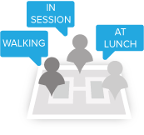
User Context
Localization helps determine a person's context—what their situation/activity is!
Mobile phone location not necessarily a proxy for user location (see Patel et al. 2006)

Slide 4
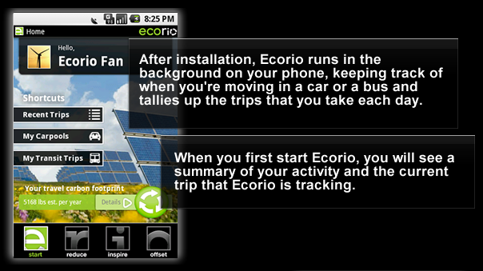

Slide 5
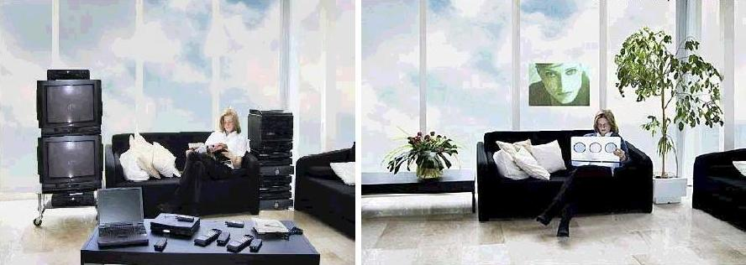
Ubiquitous Computing
See also: Weiser, Mark (1991) The computer for the 21st century. Scientific American, Sept 94-100

Slide 6
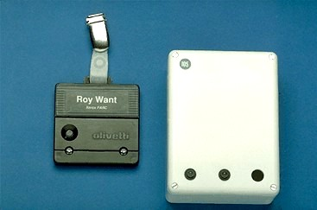
Localization History
Hightower, J. and Borriello, G. 2001. Location systems for ubiquitous computing. IEEE Computer, 34 (8), 57-66
Active Badge

Slide 7
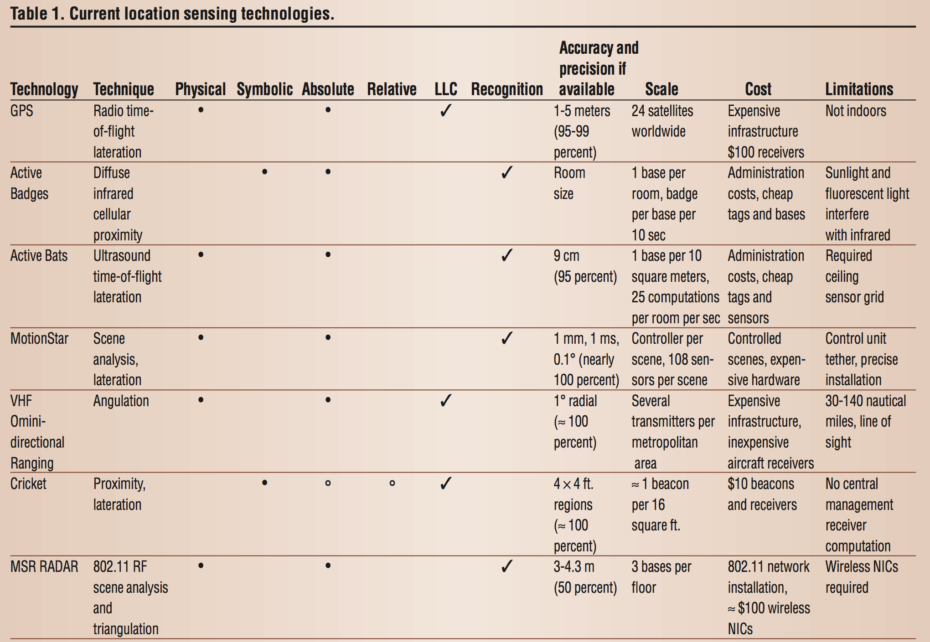
Localization History

Slide 8
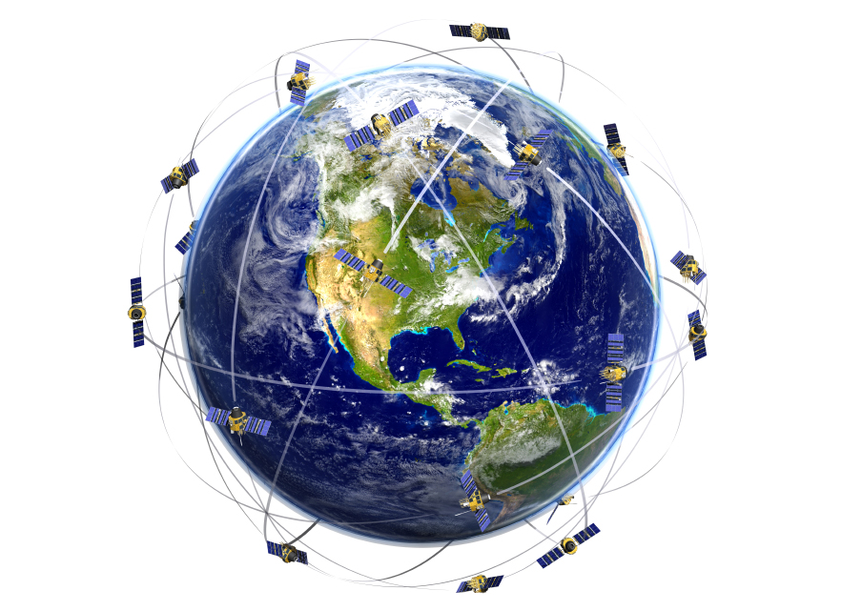
GPS: Global Positioning System
satellites

Slide 9
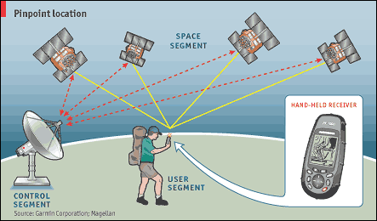
GPS: Global Positioning System
messaging

Slide 10
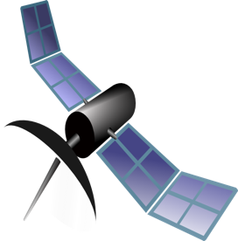
Time of Flight
Time of Transmission (TOT)
"It's 10:42:03.253!"

Slide 11
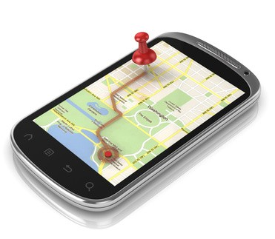
Time of Flight
Time of Transmission (TOT)
Time of Arrival (TOA)
"It's 10:42:03.253!"
I heard "It's 10:42:03.253!" at 10:24:03.256, so the satellite is .003sec away!

Slide 12
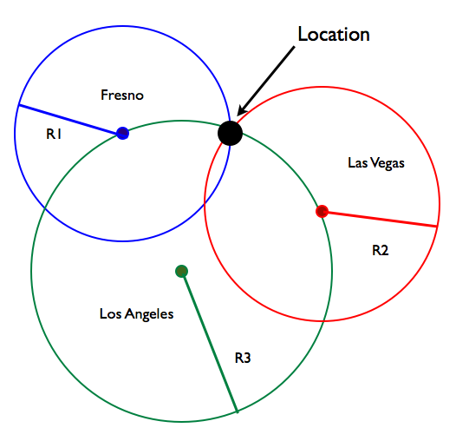
Trilateration

Slide 13
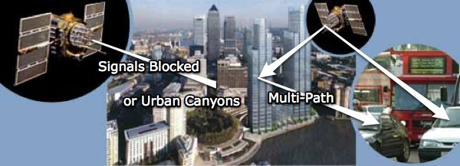
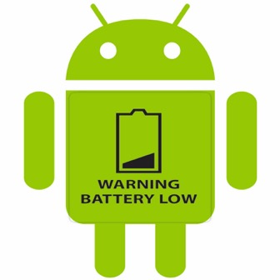
GPS Limitations

Slide 14
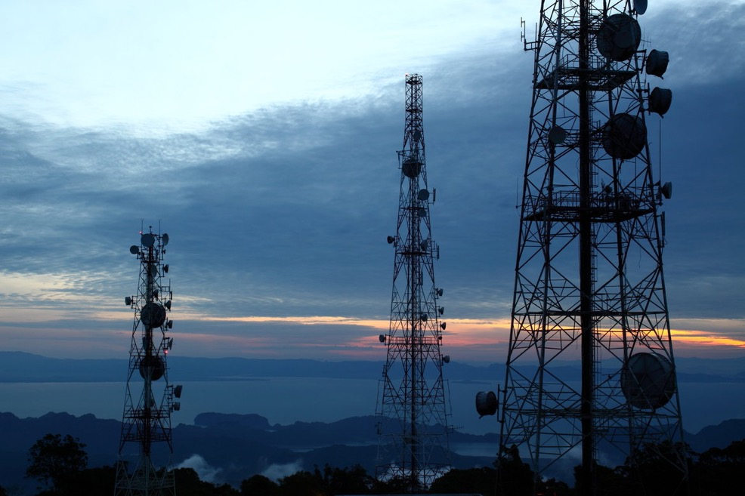
Cell Tower (GSM) Localization

Slide 15
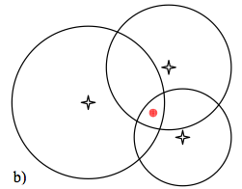
Trilateration (Errors)

Slide 16
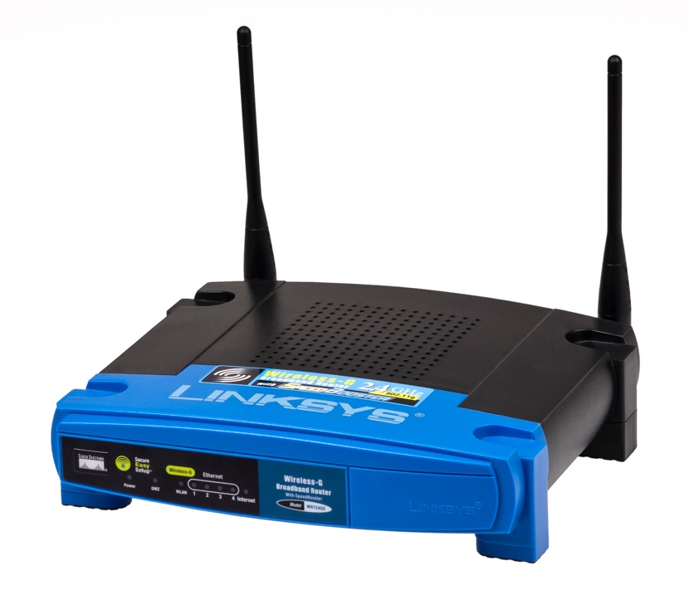
WiFi Localization

Slide 17
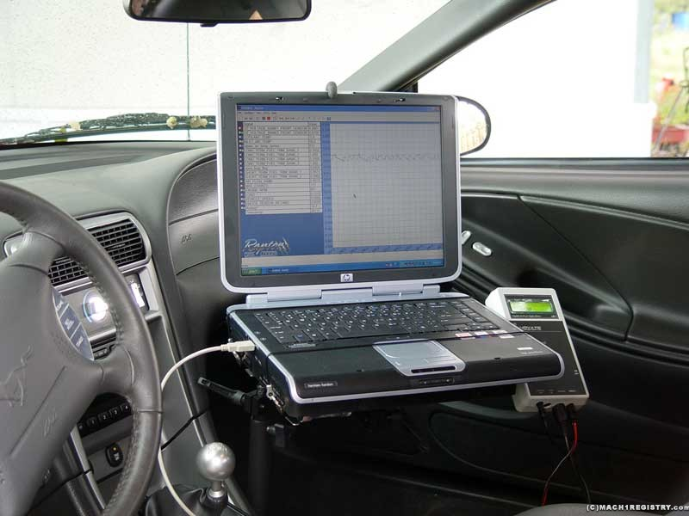
War Driving

Slide 18
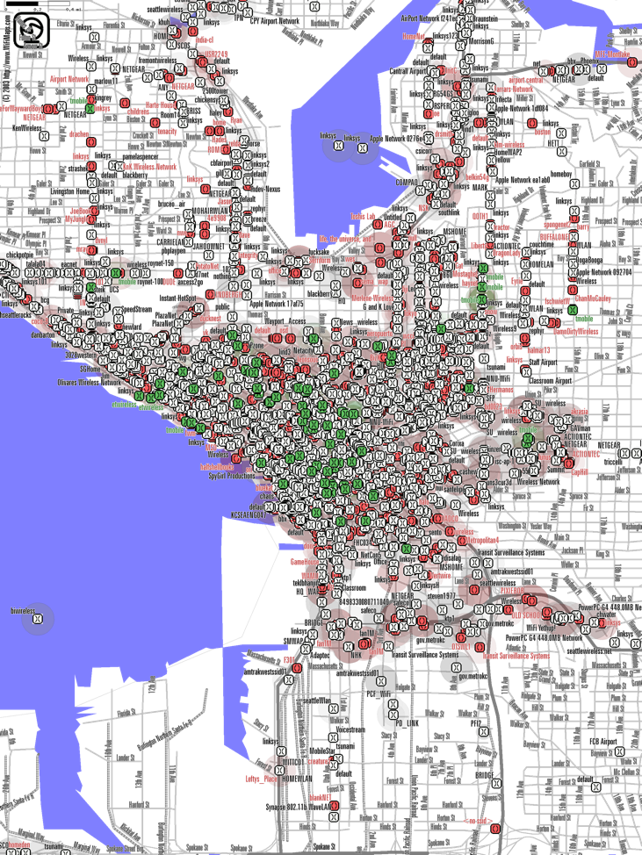
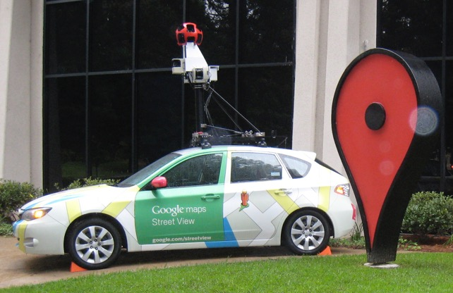

Slide 19
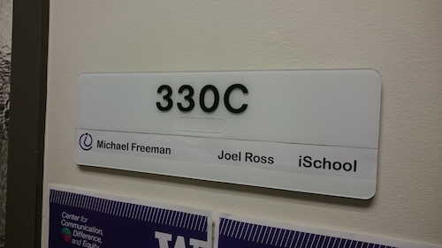
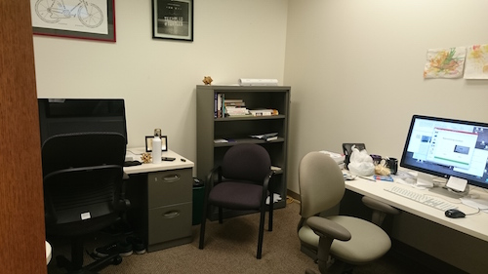
Representing Location
Space
Place

Slide 20
Measuring Latitude

Slide 21
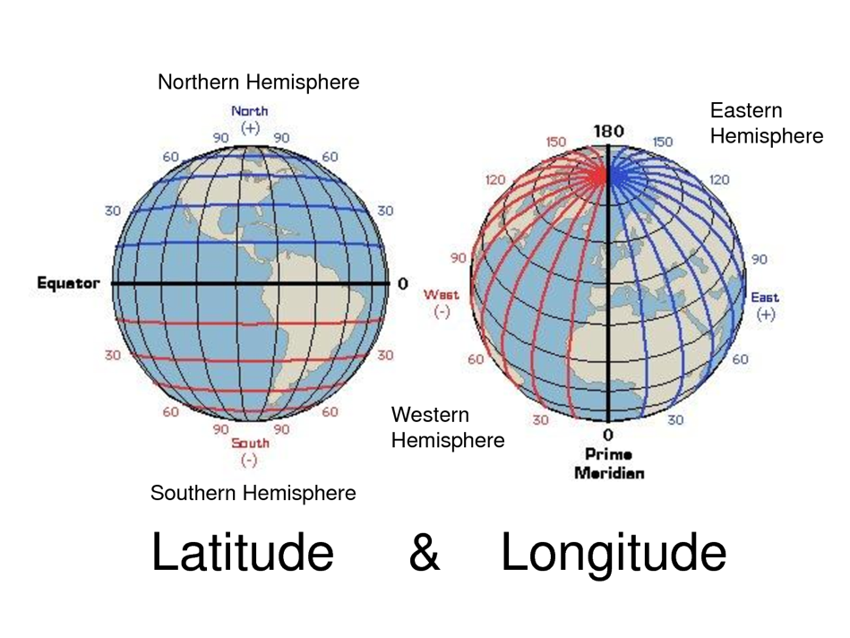
Latitude & Longitude
Rough approximation: .01 degrees ~= 1 mile

